Slide 1
C&B Biology Project

Slide 2
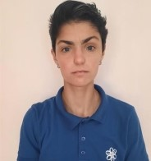
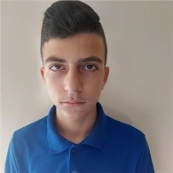
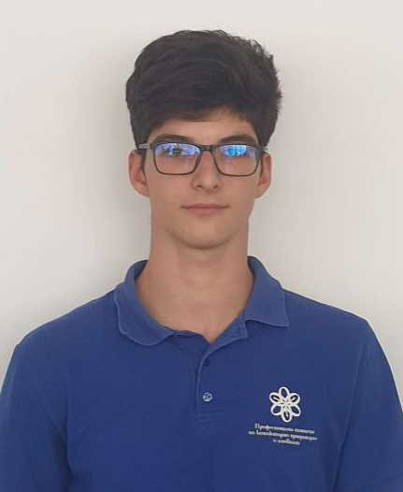
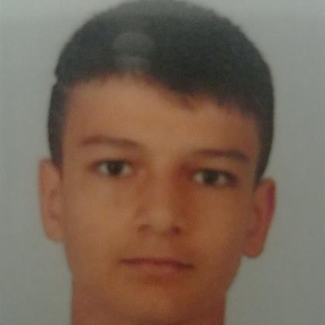
Our team
Iliyana Michevska
Scrum Trainer
Rumen Petkov
Back end
Developer
Preslav Penchev
Back end
Developer
Daniel Mihalev
Designer

Slide 3

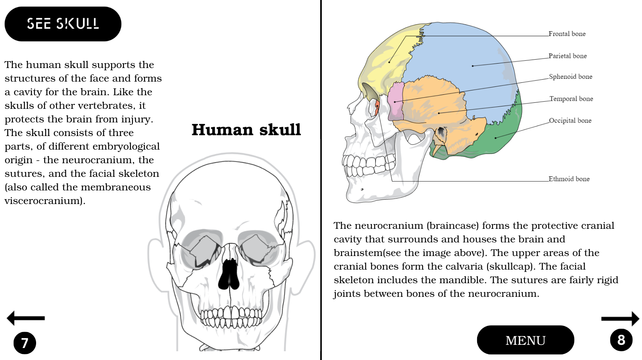
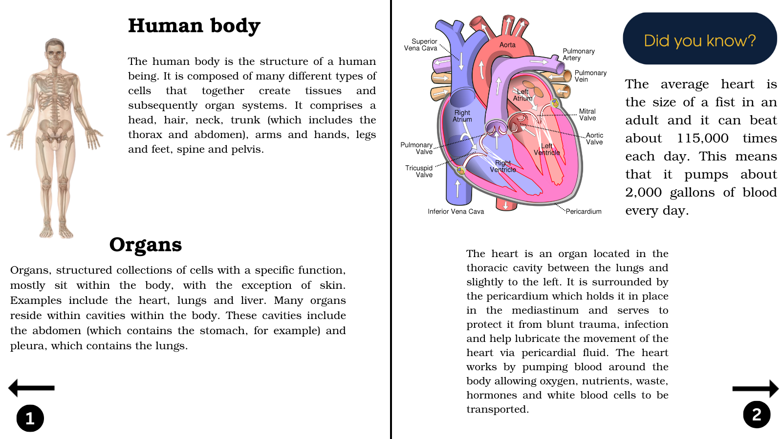
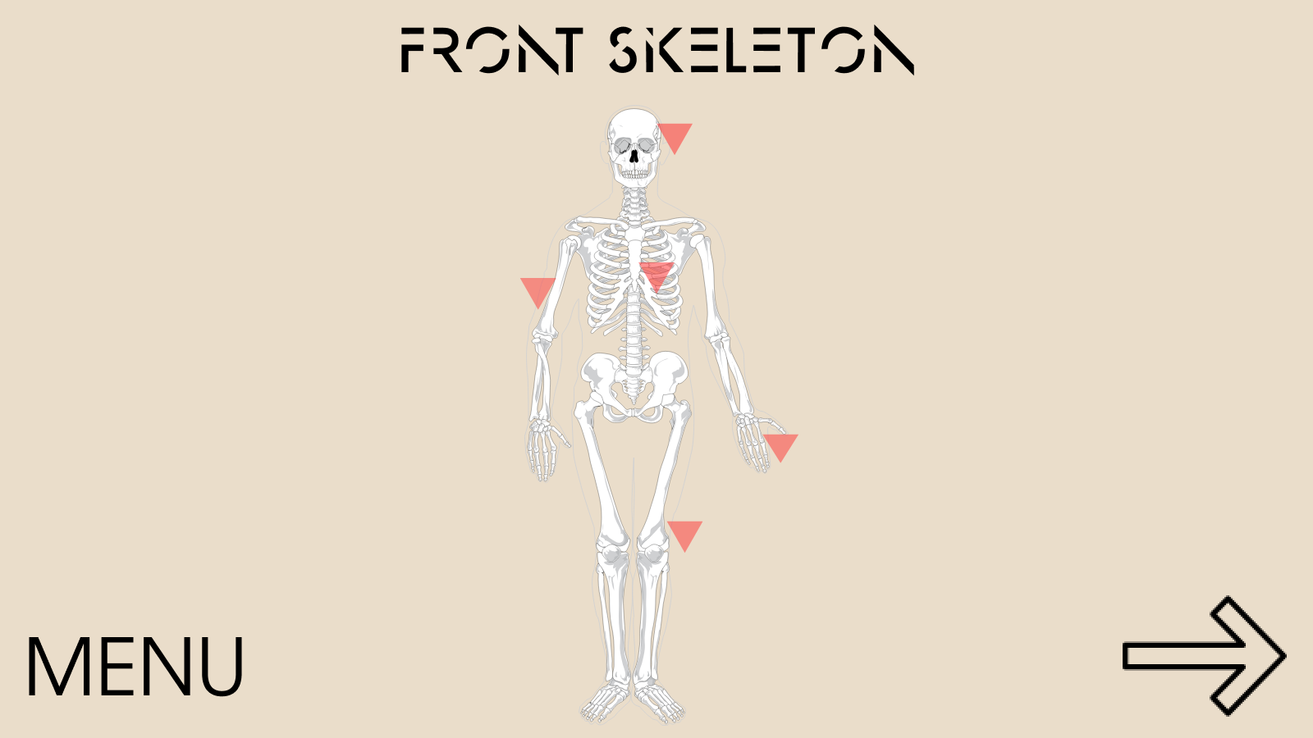
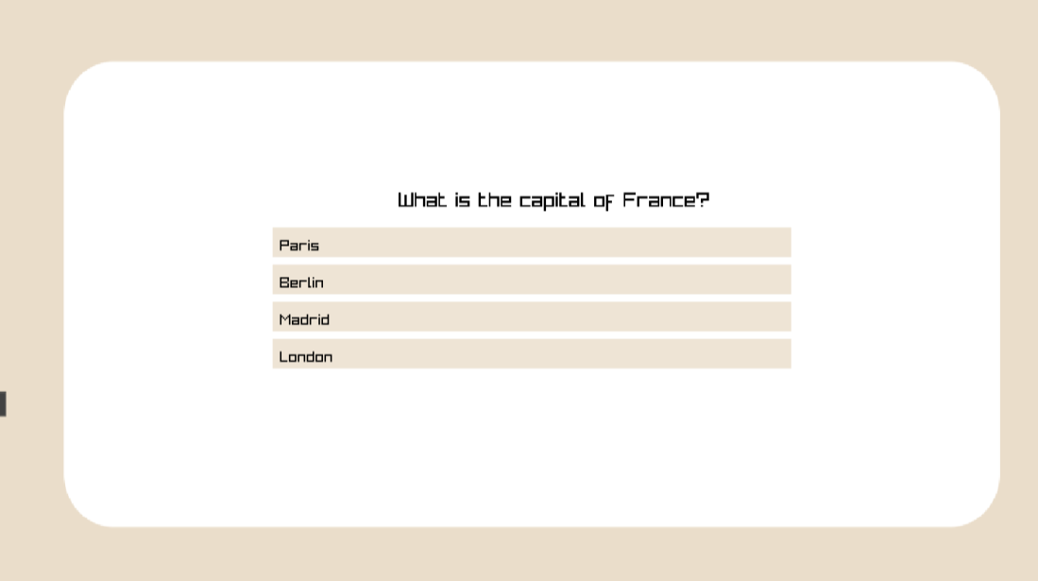
Idea of the project

Slide 4
Stages of realization
Understanding the concept
Testing our code
Presentation
Distribution of tasks
Bugs and errors correction
Final

Slide 5










Used languages and tools

Slide 6
Let’s move on to our game

